Slide 1
Hackathon 2024
Presenter: 1907_Bhavikk (Bhavikk Shah)

Slide 2
Index
Introduction
Functional and Non- Functional Requirements
Module 1
Accuracy
Reliability
Efficiency
Security
Module 2
Continuous market scanning
Dynamic data integration
Real-time property analysis and scoring
Future directions

Slide 3

1. Introduction
Collaborative approach!
Perspective on the problem statement
Tech-stack employed

Slide 4

1. Introduction
Collaborative approach!
Perspective on the problem statement
Tech-stack employed

Slide 5










1. Introduction
Collaborative approach!
Perspective on the problem statement
Tech-stack employed

Slide 6
Functional and Non-Functional Requirements
Functional Requirements
Property Listings: Users should be able to view property listings with details such as price, location, and description.
Search Functionality: Users should be able to search for properties based on location
Scraping Properties: The scraper should fetch property details from defined sources and store them in the database.
Analytics : An analytics module should be available to provide insights and trends about the real estate market.
Non-Functional Requirements
Performance: The application should load property listings within 3 seconds.
Scalability: The system should handle up to 10,000 concurrent users without significant degradation in performance.
Security: The application should follow OWASP security practices to protect against common vulnerabilities.
Maintainability: Code should be modular and well-documented to facilitate maintenance and updates.
Reliability: The application should have an uptime of 99.9%.

Slide 7

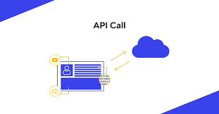




3. Module 1
Data Collection, Integration, and Management Module Overview

Slide 8
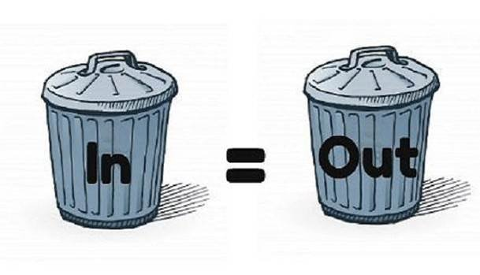
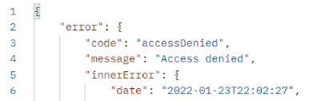

3.1 Accuracy

Slide 9
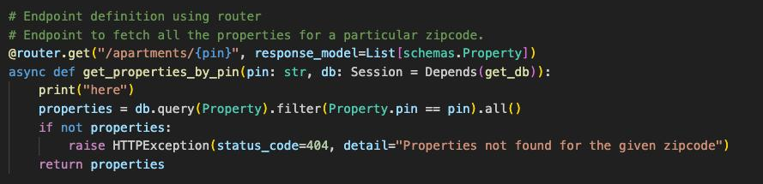
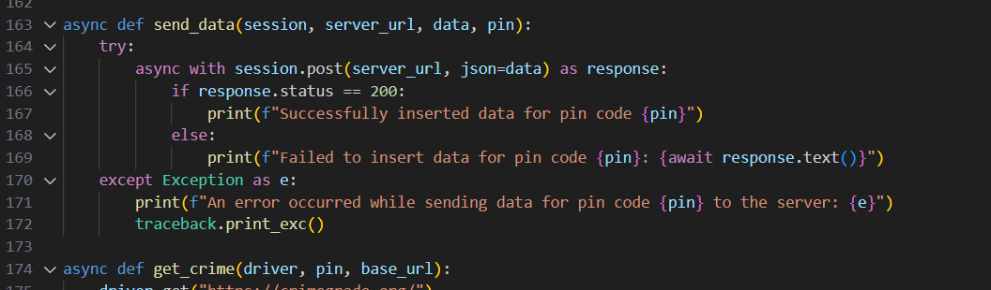
3.2 Reliability
Retry mechanisms
Best coding practices
Exception handling mechanism

Slide 10
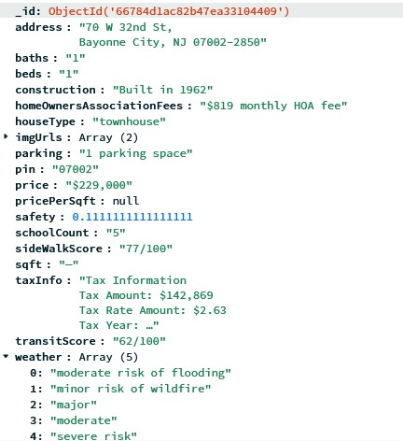
3.3 Efficiency
Asynchronous processing
Time complexity measures
Hashing
Modular programming
DB design (3NF)

Slide 11
2.4 Security
System Design
staging data
FACTS data
Redfin, Marcusmillichap,
Realtor, Zillow, Homes
Selenium bot
MongoDB staging database
Analytics script
AWS RDS MySQL
Data abstraction layer
Enables real-time
Docker
Flask Backend
React Frontend
Instance
Reports

Slide 12
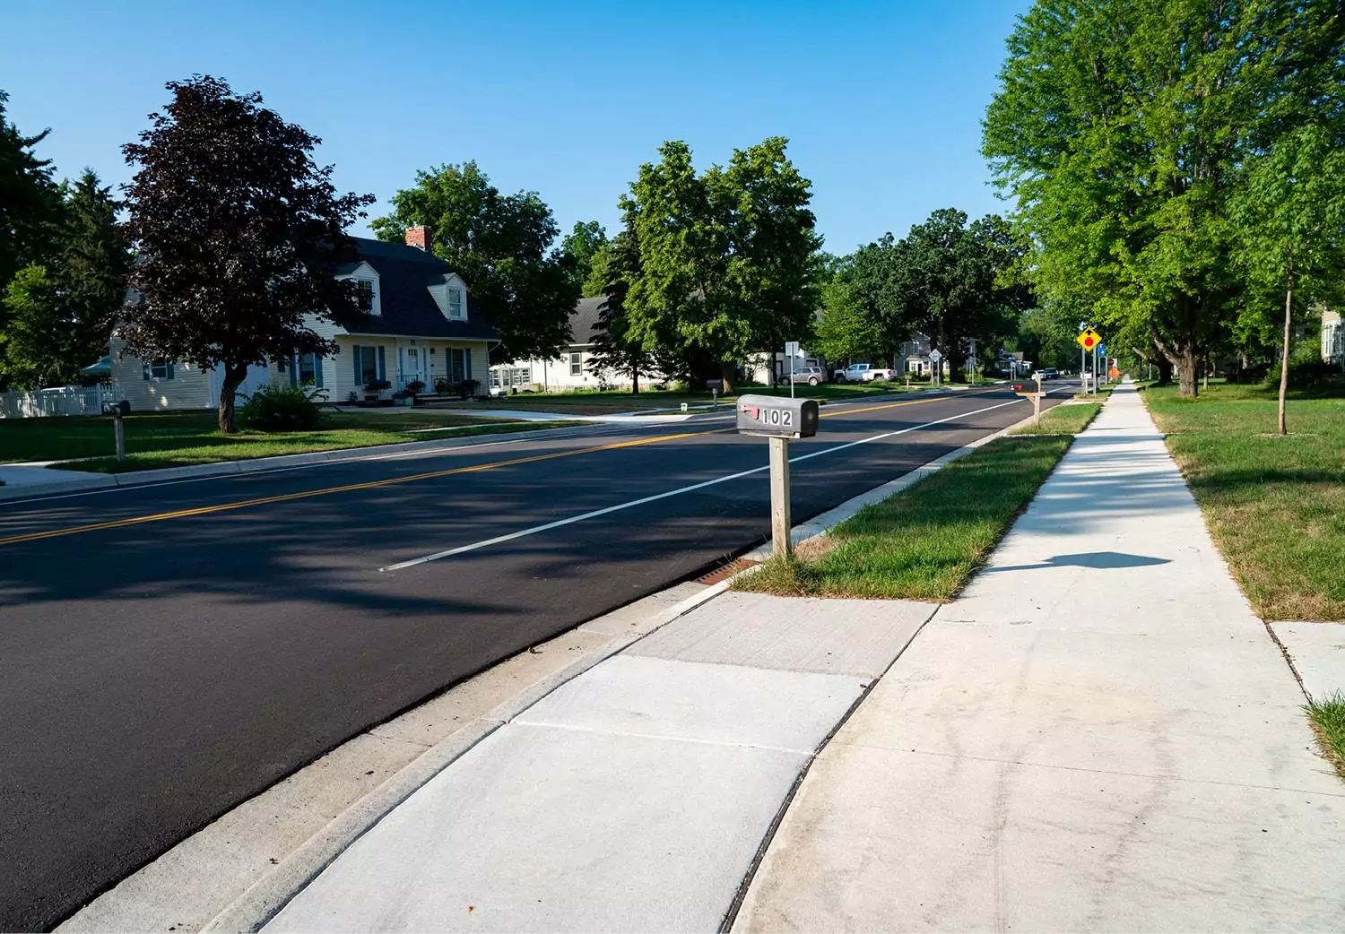
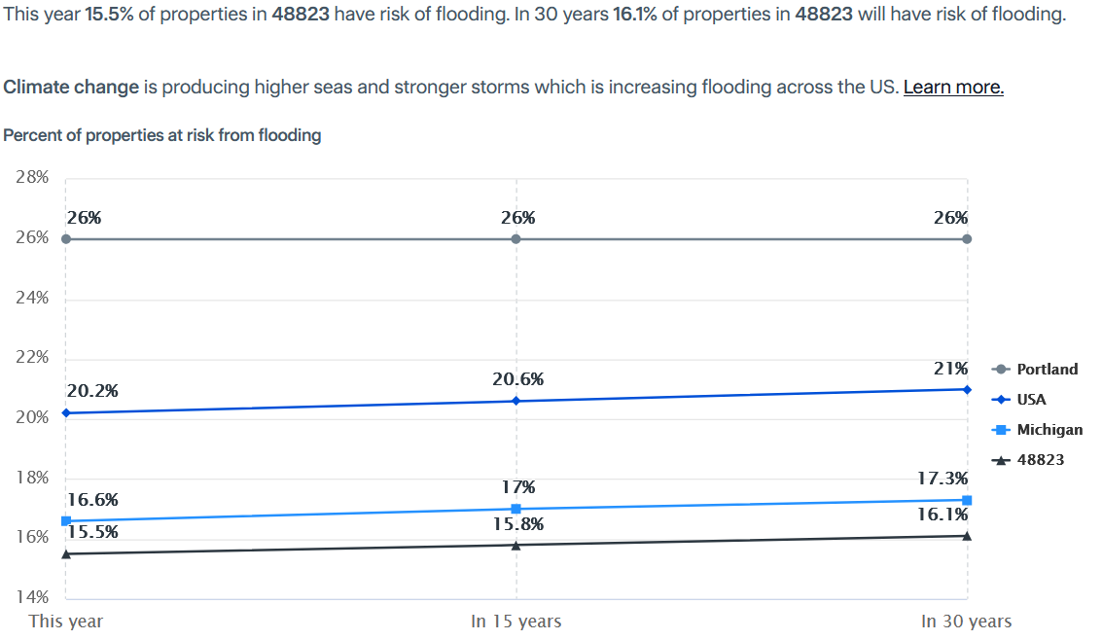
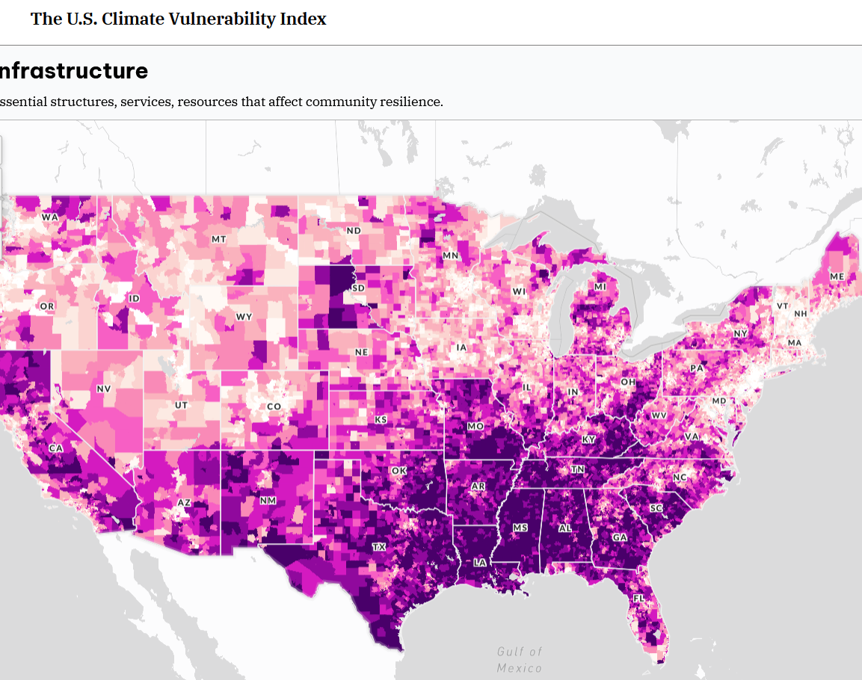
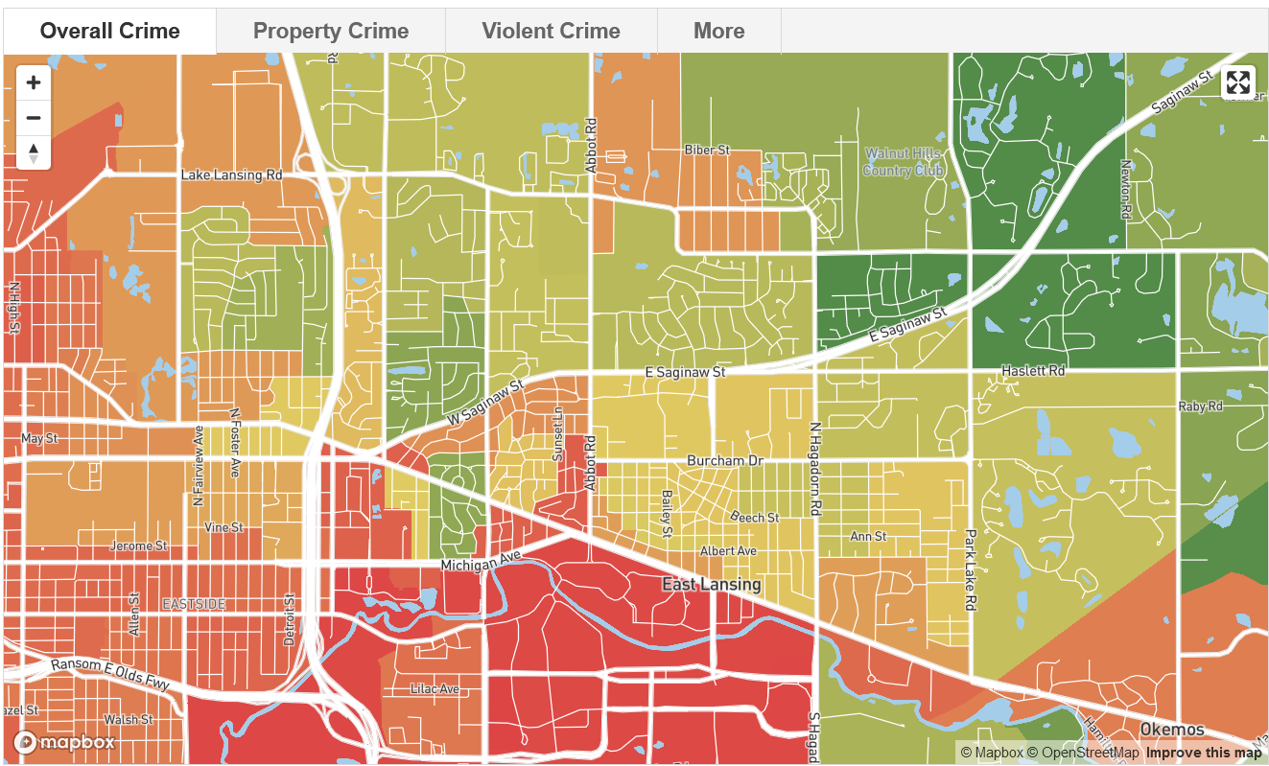

4. Module 2
Market Analysis

Slide 13
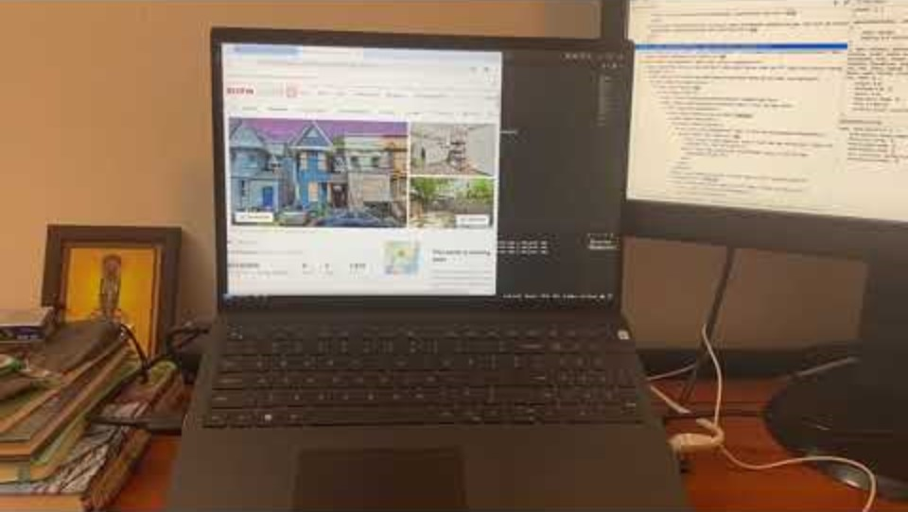
4.1 Continuous market scanning

Slide 14
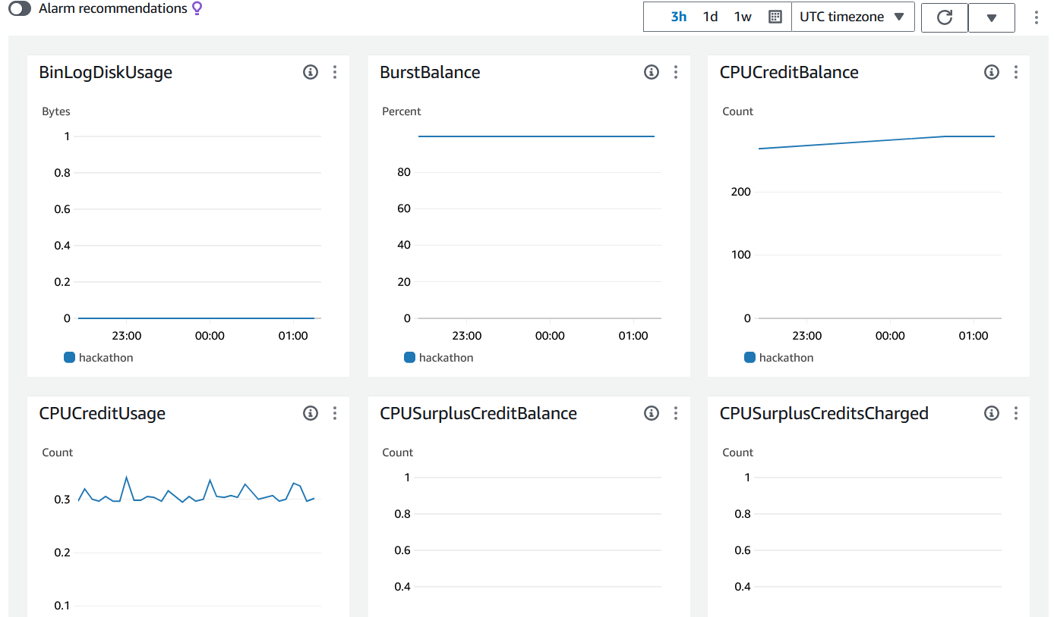
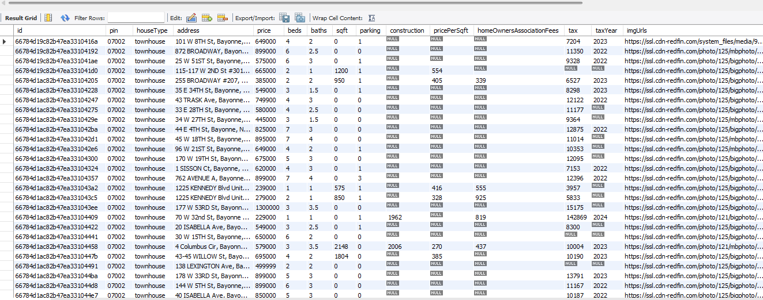
4.2 Dynamic data integration

Slide 15
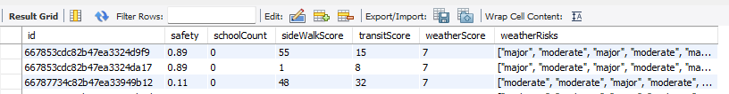
4.3 Real time property scoring

Slide 16
5. Future directions
Financial underwriting
Personalized real estate AI recommendation system
Loan / Mortgage assistance

Slide 17
Thank you

